Slide 1

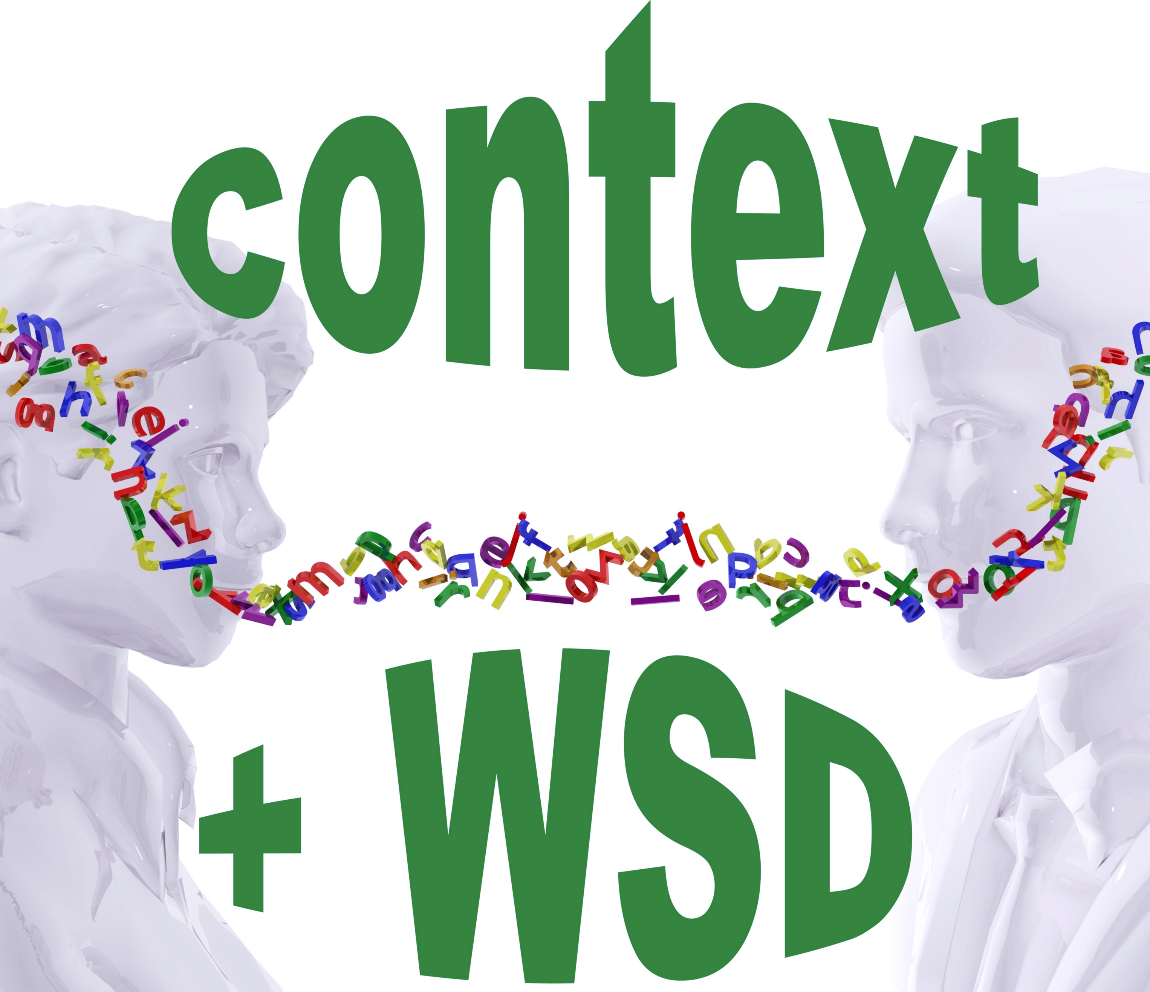
A Game – Theoretic Approach to Word Sense Disambiguation
Rocco Tripodi Marcello Pelillo

Slide 2
Introduction
New model for Word Sense Disambiguation (WSD) formulated in terms of evolutionary game theory
Word Sense Disambiguation: the task of identifying the intended meaning of a word based on the context in which it appears
“There is a financial institution near the river bank”
Financial sense
Naturalistic sense
Notes:
30’’
Julie

Slide 3
Approaches based on
Learning models
Supervised
Unsupervised
Semi-supervised
Techniques
Heuristic
Algorithms
Graph-based
Knowledge-based
Remain on the surface of the word, compromising the coherence of the data to be analyzed
Background
Notes:
30’’
Julie

Slide 4

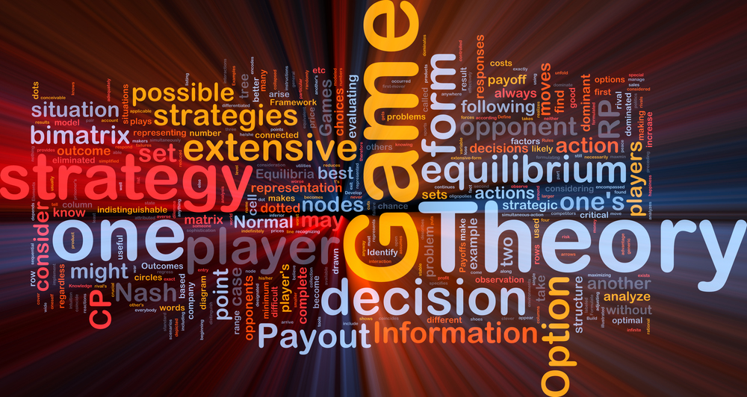

Game Theory
Mathematical approach to study the interaction between two or more individuals
Outcome → benefits and costs depend on the strategies of each other
Players $I=\left\{\text{1, .., }\text{n}\right\} →N:$ total number of players
Pure player strategy set $S_{i}=\{ s_{1}, s_{2}, … , s_{M }\}$, $M$ : total number of strategies
Mixed player strategy set $x_{i}=\{ x_{11}, x_{12}, …, x_{1M} \}$, $x_{h}$ : probability of player $i$to choose its $h−th$ pure strategy
Utility function $u_{i} :S_{1} × S_{2} × … × S_{N}→ℝ$
strategies → payoffs
combination of strategies played by all players
Classical game theory VS Evolutionary game theory
Static VS Dynamic strategies
Evolutionary game theory $→$ dynamics of strategy change through repeated games
Nash equilibrium → set of strategy profiles in which each strategy is a best response to the strategy of the co-players and no player has the incentive to deviate from their decision ( changing strategy $↛$ payoff increase )
Payoff → value associated with a possible outcome of a game ( set of strategies )
Notes:
2’
Theatina

Slide 5
Proposed System
Evolutionary game theory framework
First attempt in the specific NLP task of WSD
WSD
Sense - labelling task → sense assignment to words
Constraint satisfaction problem
Game-theoretical approach
Players → words ( to be disambiguated )
Strategies → senses ( evolving population )
Payoff matrices → sense similarity
Interactions → weighted graph
Nash equilibrium → consistent word-sense assignment
Selection process
Iterative process of fitness increase ( candidates / senses with certain features )
Best candidates ( senses with higher fitness ) in the population
Notes:
Theatina

Slide 6
Proposed System
Consistent final labelling of the data
The solution of the problem is always found
System convergence to the nearest Nash equilibrium
(Nash Theorem 1951)
Target word
WSD
Continuous optimization problem
Exploitation of contextual information in a dynamic way
Versatile approach
Adaptive to different scenarios and tasks
Most appropriate sense association
(evolutionary game theoretic framework)
Unsupervised / Semi-supervised
Notes:
Julie

Slide 7

Data Modelling
Data Geometry
Strategy Space
Payoff
System Dynamics & Sense Classification

Slide 8

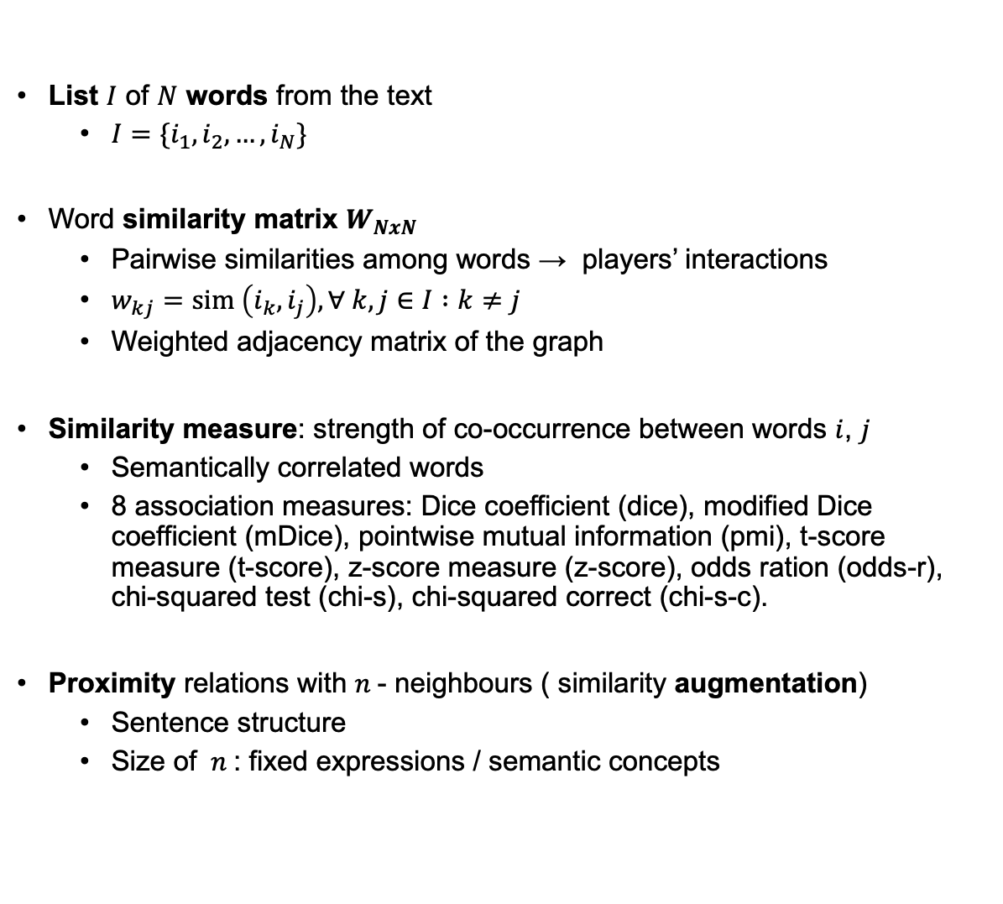
Data Geometry
List $I$ of $N$ words from the text
$I=\{i_{1}, i_{2}, …, i_{N}\}$
Word similarity matrix $W_{NxN}$
Pairwise similarities among words → players’ interactions
$w_{kj}=sim \left(i_{k},i_{j}\right), ∀ k,j∈I :k≠j$
Weighted adjacency matrix of the graph
Similarity measure: strength of co-occurrence between words $i$, $j$
Semantically correlated words
8 association measures: Dice coefficient (dice), modified Dice coefficient (mDice), pointwise mutual information (pmi), t-score measure (t-score), z-score measure (z-score), odds ration (odds-r), chi-squared test (chi-s), chi-squared correct (chi-s-c).
Proximity relations with $n$- neighbours ( similarity augmentation)
Sentence structure
Size of $n$: fixed expressions / semantic concepts
Notes:
2’
Theatina

Slide 9
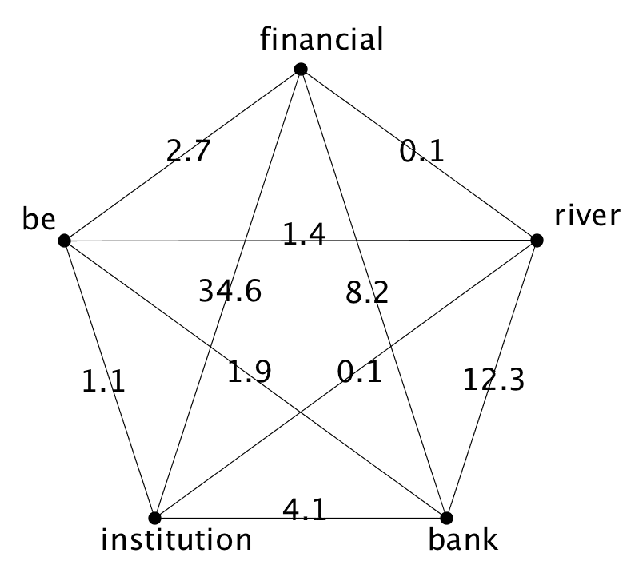
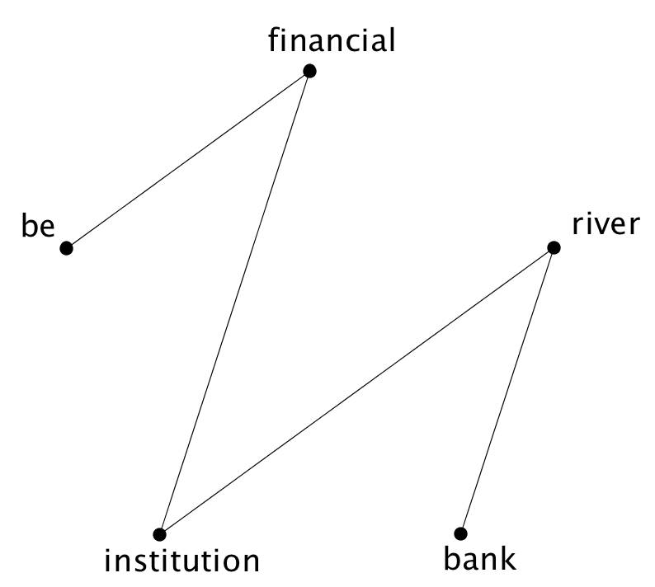
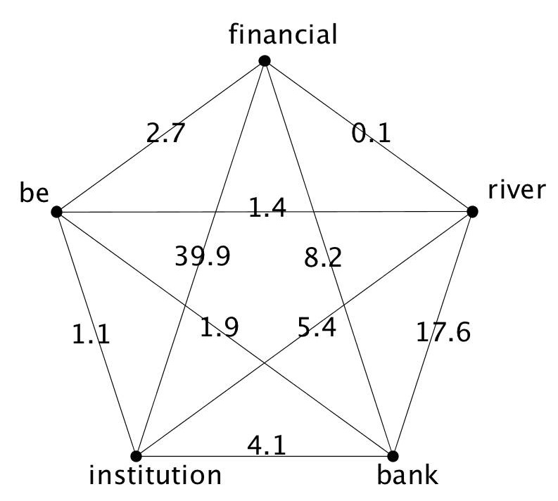
Data Geometry
Notes:
Theatina

Slide 10


Strategy Space
Sense inventories of each word $i∈I$
$M_{i}=\{ m_{i1},m_{i2}, … , m_{ik} \}$, where $k=|M_{i}|$ the number of senses associated with word $i$
WordNet and BabelNet as knowledge base
Player strategy space
$Δ_{p}=\{ x_{p}∈ℝ^{n} : \sum_{i=1}^{n}{x_{pi}}=1, where x_{pi}≥0 for i=0,1, …, n\}$
$n$: number of pure strategies of player $i$ and each component
$x_{pi}$ : probability that player $p$ chooses its $i−th$ pure strategy
Graphical representation: regular polygon of radius 1, where the distance from the centre to any vertex (mixed strategy) represents the probability associated with a particular word sense (pure strategy)
Unique concepts in sense inventories
Game space $C=\left\{ c_{1}, c_{2}, …, c_{u}\right\}$ , where $u$ the total number of unique concepts
Assignment of probability distribution over the senses in $C,$for each word $i∈I$
Notes:
2’
Theatina

Slide 11
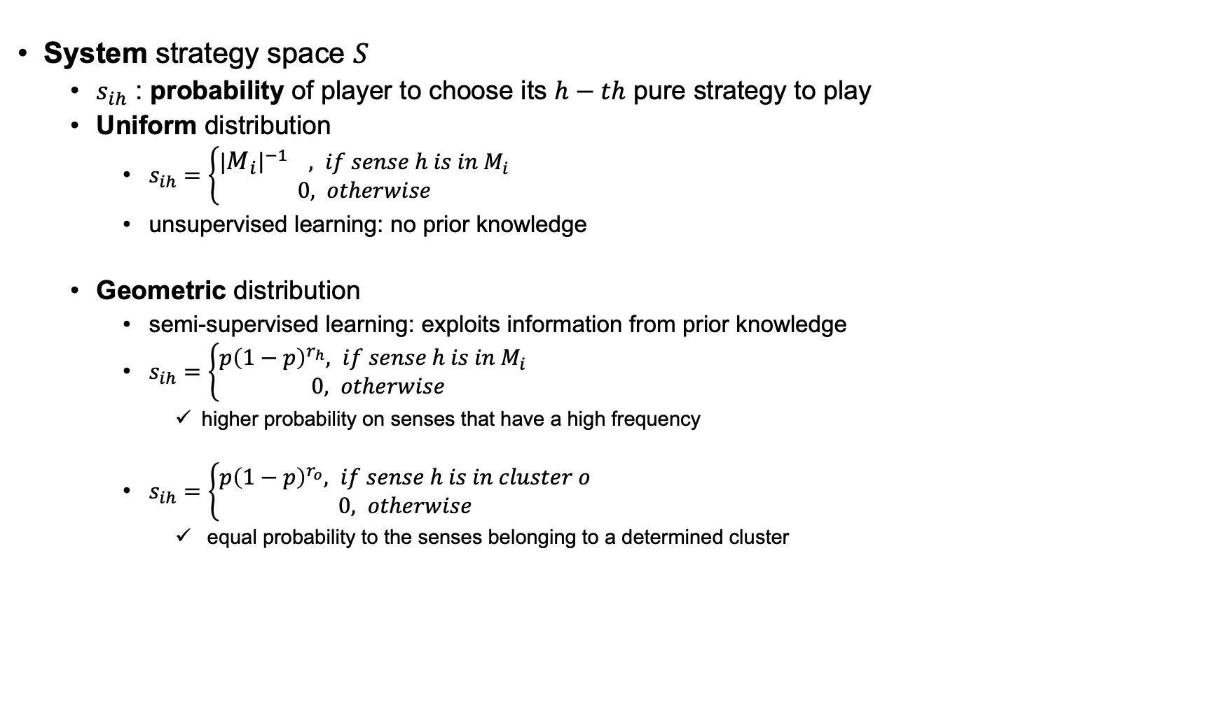
Strategy Space
System strategy space $S$
$s_{ih}$ : probability of player to choose its $h−th$ pure strategy to play
Uniform distribution
$s_{ih}=\left\{\begin{aligned}|{\left.​M_{i}\right|}^{−1} , if sense h is in M_{i} \\ 0, otherwise\end{aligned}\right.$
unsupervised learning: no prior knowledge
Geometric distribution
semi-supervised learning: exploits information from prior knowledge
$s_{ih}=\left\{\begin{aligned}p{\left(1−p\right)}^{r_{h}}, if sense h is in M_{i} \\ 0, otherwise\end{aligned}\right.$
higher probability on senses that have a high frequency
$s_{ih}=\left\{\begin{aligned}p{\left(1−p\right)}^{r_{o}}, if sense h is in cluster o \\ 0, otherwise\end{aligned}\right.$
equal probability to the senses belonging to a determined cluster
Notes:
1’
Theatina

Slide 12

Sense similarity matrix $Z$
Pairwise similarity among senses in $C$ $→$partial payoff matrices of each game
$z_{ij}=ssim\left(s_{i}, s_{j}\right), ∀i,j∈C, i≠j$
Partial payoff matrix:
Games played between two words $i, j$
Dimension $\left|M_{i}\right| × |M_{j}|$ , $\left|M_{k}\right|$ : cardinality of senses set of word $k$
Semantic similarity
Relations of likeness ( “is-a” )
wup: path length among two senses $s_{i}, s_{j}$
$ssim_{wup}\left(s_{i}, s_{j}\right)=2∗\frac{depth\left(msa\right)}{depth\left(s_{i}\right)+depth\left(s_{j}\right)}$
$msa$: “most specific ancestor”
jcn measure: corpus statistics and structural properties
$ssim_{jcn}\left(s_{i}, s_{j}\right)=IC\left(s_{1}\right)+IC\left(s_{2}\right)−2 IC\left(msa\right)∗\frac{depth\left(msa\right)}{depth\left(s_{i}\right)+depth\left(s_{j}\right)}$
$IC\left(s_{i}\right)=−log⁡(p(s_{i}))$
Payoff
Notes:
1’
Julie + Theatina

Slide 13

Payoff
Semantic relatedness
Similarity among the definitions of two concepts
Wider range of relations ( “is-a-part-of”, “is-the-opposite-of” )
Definitions derived from glosses of the synsets in WordNet
Co-occurrence vector $v_{i}=(w_{1i}, w_{2i} , … , w_{ni})$ , $i$: concept, $w$ : word gloss occurrences, $n$ : total words
Cosine similarity
$sim\left(v_{i}, v_{j}\right)=cos⁡θ=\frac{v_{i} ∙{ v}_{j}}{\left\|v_{i}\right\| \left\|v_{j}\right\| }, i,j$: concepts
$\left\|v_{i}\right\|=\sqrt{\sum_{j=1}^{n}{w_{ji}}}$
cosine of the angle $θ$ between the two co-occurrence vectors $v_{i}, v_{j}$
4 variations (construction of vectors)
Difference in co-occurrence calculation, corpus use and relation source
tf-idf, tf-idf_ext, vec and vec_ext
Notes:
1’
Julie + Theatina

Slide 14

System Dynamics & Sense Classification
Computation of the Nash equilibrium
Expected fitness of sense $h$( word $i$)
$u_{i}\left(e^{h}\right)= \sum_{j∈N_{i}}{{\left( w_{ij}, Z_{ij}, x_{j}\right)}_{h}}$ , where $N_{i}$ the neighbours (context) of word $i$
Pure strategy $h$: ${ e}^{h}$
Similarity with word $j$ : $w_{ij}$
Similarities among senses of $i,j$ : ${ Z}_{ij}$
Sense preference of word $j$ : ${ x}_{j}$
Average fitness of population
$u_{i}\left(x\right)= \sum_{j∈N_{i}}{ x_{i}^{T} \left( w_{ij}, Z_{ij}, x_{j}\right)}$
Replicator Dynamics Equation
$x_{i}^{h}\left(t+1\right)=x_{i}^{h}\left(t\right) \frac{u_{i}\left(e^{h}\right)}{u_{i}\left(x\right)}$ , $∀ h∈S_{i}$
Models the change in sense frequency
Depends on performance → measured relatively to the average fitness of population
Notes:
2’
Theatina

Slide 15

System Dynamics & Sense Classification
Classification
Unique strategy $s∈S→$ each word $i∈I$
The strategy with the highest probability is chosen
$φ_{i}=argmax\left( x_{ih} \right)$ , where $h=1, 2, …, \left|C\right|, \left|C\right|$ total number of senses
Each word $i∈I$ is mapped to exactly one sense $c∈C$
Word fails to be disambiguated
Unable to update its strategy space
Strategy space initialized with a uniform distribution
Zero entry payoff ( no similar senses with co-players)
Not connected with other nodes in the graph
Notes:
2’
Theatina

Slide 16
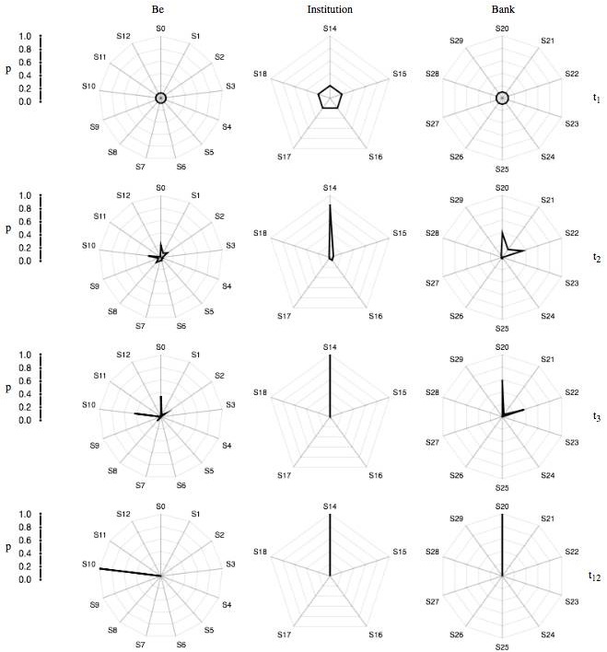
System Dynamics & Sense Classification
Notes:
T=t1: equiprobable senses
T=t2: senses are discarded
Player: “bank”
Game with “financial” & “institution → financial sense
Game with “river” → naturalistic sense
T=t12 : Final decision (naturalistic meaning)
Theatina

Slide 17
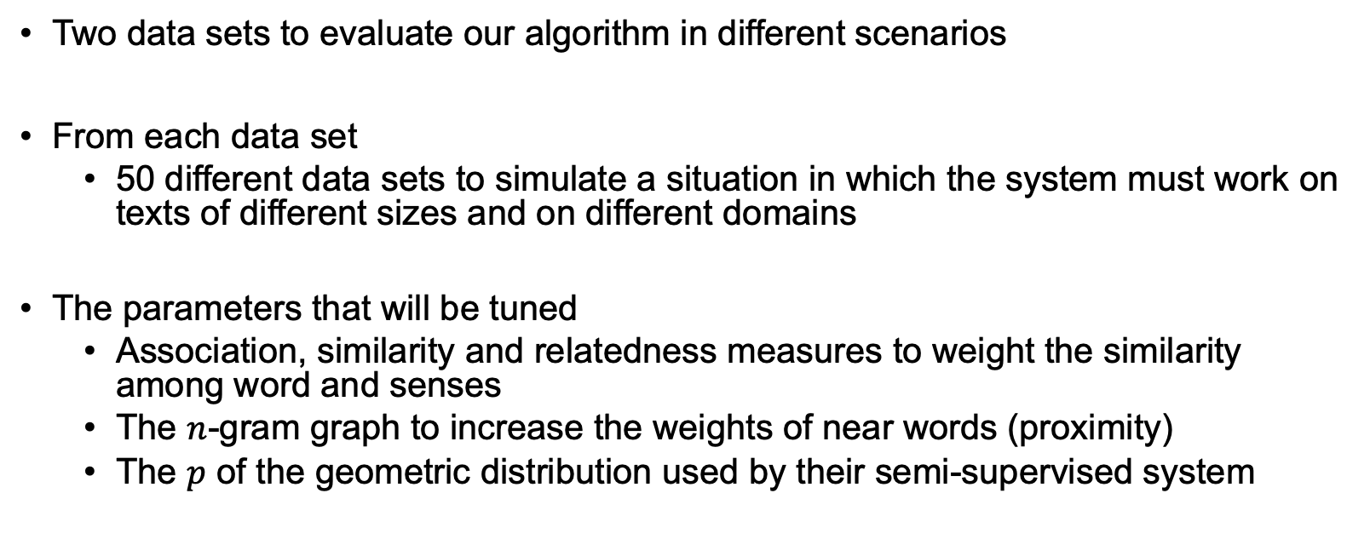
Parameter Tuning
Two data sets to evaluate our algorithm in different scenarios
From each data set
50 different data sets to simulate a situation in which the system must work on texts of different sizes and on different domains
The parameters that will be tuned
Association, similarity and relatedness measures to weight the similarity among word and senses
The $n$-gram graph to increase the weights of near words (proximity)
The $p$ of the geometric distribution used by their semi-supervised system
Notes:
30’’
Julie

Slide 18

Parameter Tuning - Results
Association, Semantic & Relatedness Measures
The relatedness measures perform significantly better than the semantic similarity measures
Particularly suitable measures for the algorithm
mdice
Tf-idf
$n$- gram Graph
Highest results on both data sets using $n$ = 5 ( $n$nearest neighbours)
Geometric Distribution:
Best results obtained with $p=0.4$
Notes:
30’’
Julie

Slide 19


Evaluation set-up
Results are provided as balanced F-score (${ F}_{1}$ ) measure
$F_{1}$: determines the weighted harmonic mean of precision and recall
$F_{1}=2 ∙ \frac{precision ∙ recall}{precision + recall} × 100$ ( % )
Evaluation based on
Experiments with WordNet as Knowledge base
The best performance on nouns on all the data sets
Low results on verbs on all data sets
The use of prior knowledge is beneficial in general domain data sets
Experiments with BabelNet as Knowledge base
We used BabelNet to collect the sense inventories of each word to be disambiguated and NASARI to obtain the semantic representation of each sense
This data set contains highly ambiguous mentions
Notes:
Julie

Slide 20
Comparison to state-of-the-art algorithms
WordNet:
Our unsupervised system performs better than any other unsupervised algorithm in all datasets
The performance of our system is more stable on the four datasets
The comparison with semi-supervised systems shows that our system always performs better than the most frequent sense heuristic when we use information from sense-labeled corpora
BabelNet:
The performance of our system is close to the results obtained with Babelfy on S13 and substantially higher on KORE50
It is also difficult to exploit distributional information on this data set because the sentences are short and, in many cases, cryptic.
Notes:
1’
Julie

Slide 21
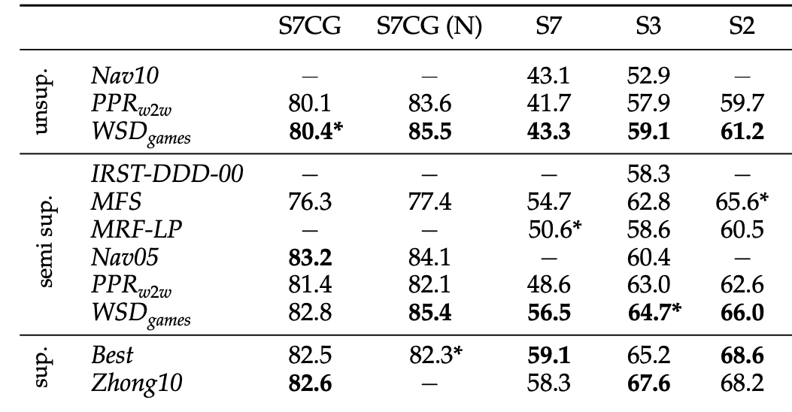
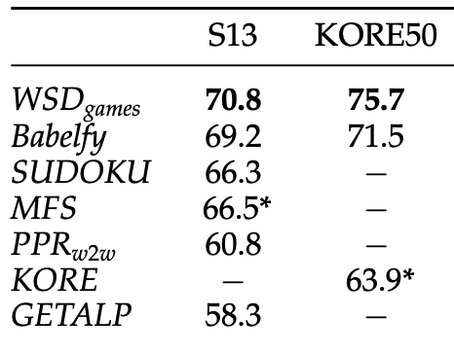
Comparison to state-of-the-art algorithms
Notes:
30’’
Julie

Slide 22
Conclusion
A new method for WSD
Evolutionary Game Theory
Similarity measures that perform better
Continuation of knowledge-based, graph-based approaches
WSD as a constraint-satisfaction problem
Consistency in the assignment of senses to related words
Development of contextual coherence on the assignment of senses (characteristic missing in many state-of-the-art systems)
Replicator dynamics equation
Best labelling assignment
Versatile
Competitive compared to state-of-the-art systems
Considers the influence of each word on the others
Imposes sense compatibility among each sense before assigning a meaning
The meaning of a word depends only on words that share a proximity relation and on those that enjoy a high distributional similarity
Unsupervised
Semi-supervised
Notes:
30’’
Julie

Slide 23

Thank you
Notes:
After our speech we got hungry so we made a toast

Slide 24



M902 – “Βασικές Μαθηματικές Έννοιες στη Γλωσσική Τεχνολογία”
Kylafi Christina-Theano
Piriasi Juliana
M.Sc. in Language Technology
Department of Informatics and Telecommunications,
National and Kapodistrian University of Athens
&
Institute for Language and Speech Processing,
“Athena” Research Center

